Slide 1
Gem5 Development

Slide 2
Outline
Analytical Model
Event Driven Simulation
Gem5 Simulator
Gem5 Objects
Simulation Workflow
Functional Extension
Gem5 Object Connection
Hardware Structure
Configuration of Hardware Components with Gem5
Ruby Cache System

Slide 3
Outline
Analytical Model
Event Driven Simulation
Gem5 Simulator
Gem5 Objects
Simulation Workflow
Functional Extension
Gem5 Object Connection
Hardware Structure
Configuration of Hardware Components with Gem5
Ruby Cache System

Slide 4
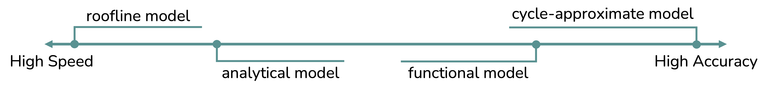
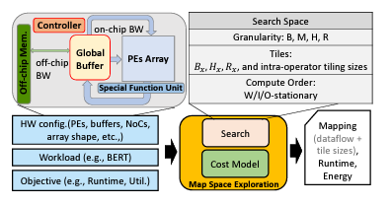
Analytical Model
Different Models of Simulation
Roofline Model
Analytical Model
Functional Model
Cycle-Approximate Model
Software & Hardware Design Space Exploration (DSE)
Number of Processing Engines (PEs)
Memory Subsystem Design and Memory Management (MGMT) Policy
Workload Partition Strategies in Multi-PE DLAs
Software / Hardware Co-Design
FLAT: An Optimized Dataflow for Mitigating Attention Bottlenecks

Slide 5
Event-Driven Simulation
Process the foremost event from the event queue
Advance the system clock to the time when the event occurred
System Tick: 2
System Tick: 2
System Tick: 50
E0
Tick 2
E1
Tick 2
E2
Tick 50
Process Event
Process Event
Process Event
E0
Tick 2
E1
Tick 2
E2
Tick 50
E1
Tick 2
E2
Tick 50
E2
Tick 50
Global Event Queue
Global Event Queue
Global Event Queue

Slide 6
Outline
Analytical Model
Event Driven Simulation
Gem5 Simulator
Gem5 Objects
Simulation Workflow
Functional Extension
Gem5 Object Connection
Hardware Structure
Configuration of Hardware Components with Gem5
Ruby Cache System

Slide 7
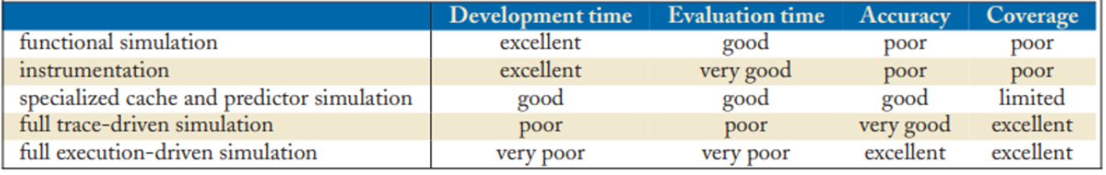
Gem5 Simulator
Michigan m5 + Wisconsin GEMS = gem5
Kinds of simulation
Functional simulation
No timing information
Used to validate correctness of compilers, etc.
RISC-V Spike, QEMU, gem5 “atomic” mode
Instrumentation-based
Often binary translation
Trace-based
Generate addresses/events and re-execute
Execution-driven
Full system
Often “Bare metal” simulation
Often means running the OS in the simulator, not faking it

Slide 8
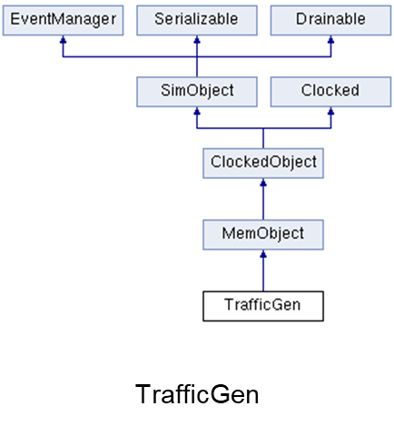
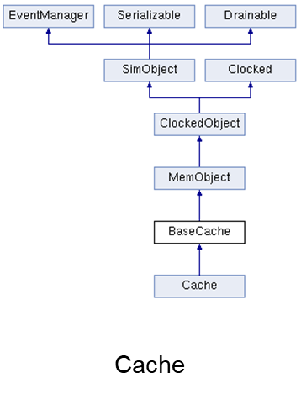
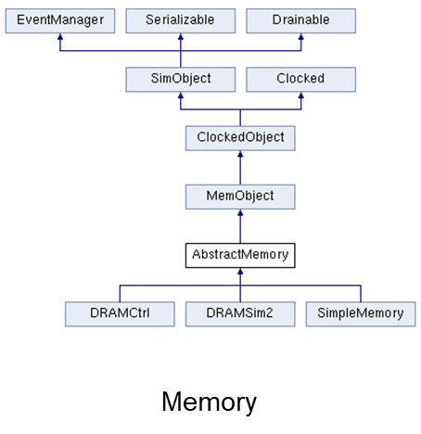
SimObject
Almost all objects in gem5 inherit from the base SimObject type
SimObjects export the main interfaces to all objects in gem5
SimObjects are wrapped C++ objects accessible from Python config scripts
Gem 5 classes & api doc

Slide 9
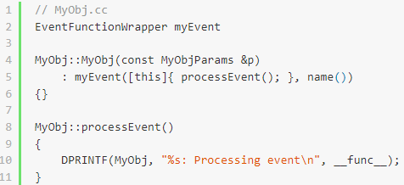
EventFunctionWrapper
Wrap function to call when event created
Dequeue from event queue and call process()
Process call function that wrapped before
System Tick: 2
E0
Tick 2
Process Event
E0
Tick 2
E1
Tick 2
E2
Tick 50
Global Event Queue

Slide 10
Packet & Request
Packet
Contain Origin Request
Contain Memory Command
Will be Delete or Copy (Not Consistent)
Request
Contain addr, size, flags, etc.
Consistent from Request to Response
Req ID 0
Write Pkt
PE
Cache
Global Cross Bar
Global Memory

Slide 11
Packet & Request – Write Miss Example
Miss at cache
Push original request to write buffer
Invalid all cache lines having the same address
Entry
0
Entry
1
Copy
Req ID 0
Write buffer Queue
Extract & push
Write Pkt
Inv Pkt
PE
Cache
Global Cross Bar
Global Memory

Slide 12
Packet & Request – Write Miss Example Cont’d
Send invalid request to downstream
Wait write buffer to send write request
Entry
0
Entry
1
Req ID 0
Write buffer Queue
Inv Pkt
PE
Cache
Global Cross Bar
Global Memory

Slide 13
Packet & Request – Write Miss Example Cont’d
New a write request pkt and send to downstream
Entry
0
Entry
1
Extract & new
Write buffer Queue
Write Pkt
PE
Cache
Global Cross Bar
Global Memory

Slide 14
Packet & Request – Write Miss Example Cont’d
New a write request pkt and send to downstream
Request never changes
PE
Req ID 0
Cache
Req ID 0
Global Cross Bar
Req ID 0
Global Memory

Slide 15
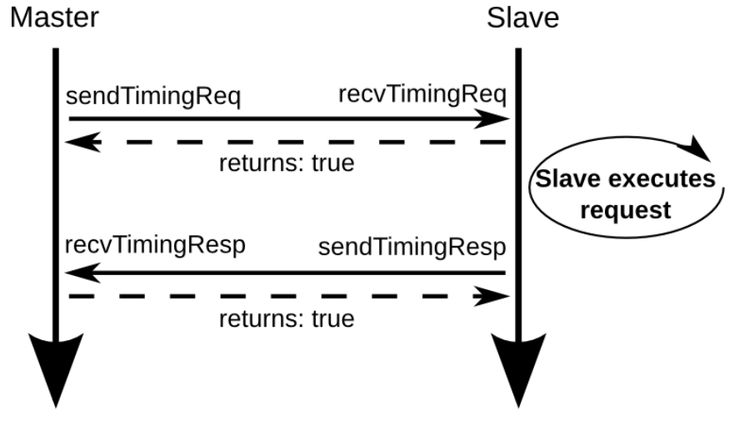
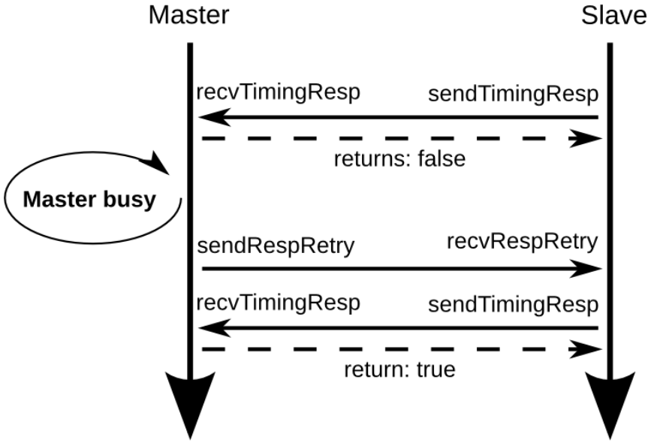
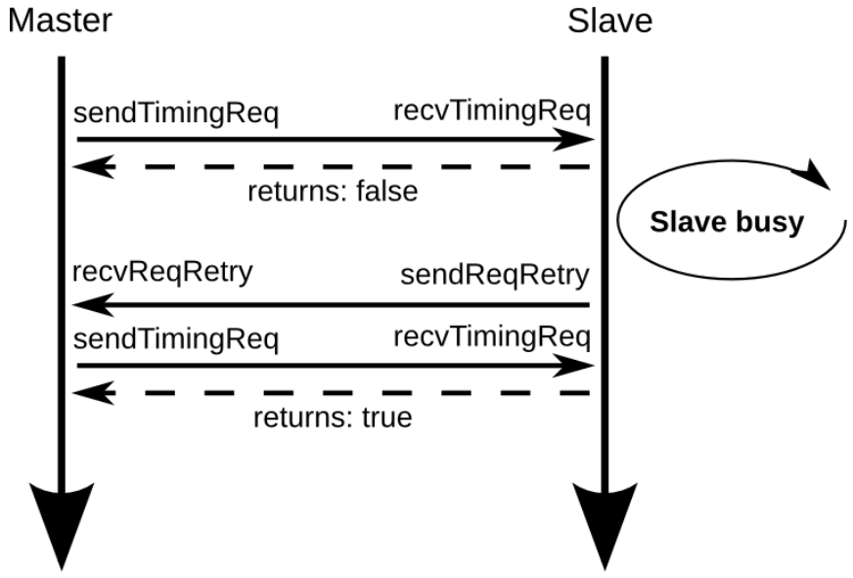
Port Interface
Success sending request
Success sending response
Failed to send request
Success sending response
Success sending request
Failed to send response

Slide 16
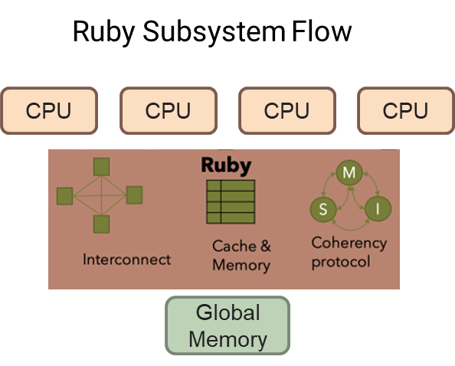
Request & Response flow
Traditional Arch Flow
PE
PE
PE
PE
Cache
Cache
Cache
Cache
Global Cross Bar
Global Memory

Slide 17
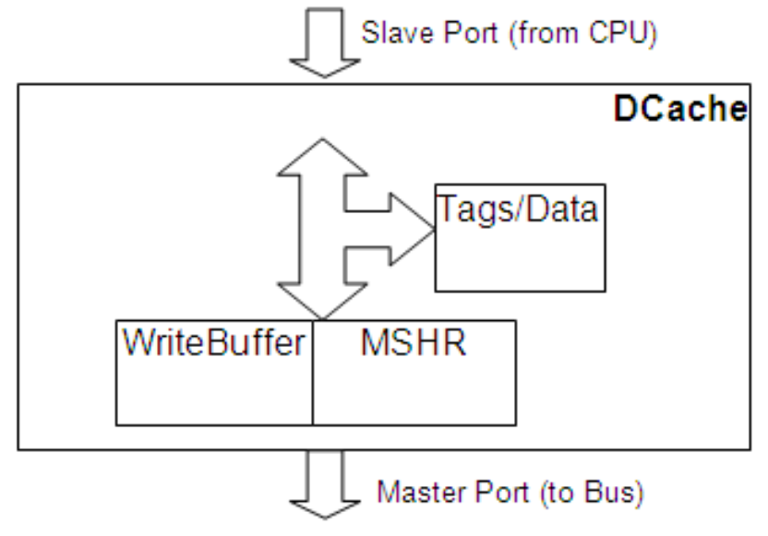
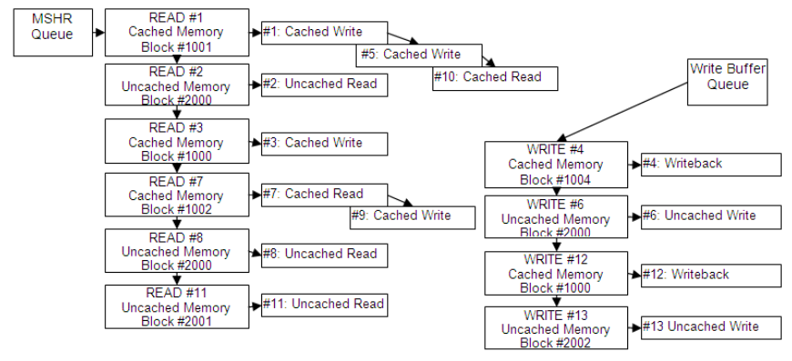
Cache request & response
Request
Hit -> Receive
Miss -> check whether mshr is full
Full -> reject
Not Full -> receive -> insert to mshr
Response
Hit -> response after handling latency
Miss -> response after mshr service target

Slide 18
Outline
Analytical Model
Event Driven Simulation
Gem5 Simulator
Gem5 Objects
Simulation Workflow
Functional Extension
Gem5 Object Connection
Hardware Structure
Configuration of Hardware Components with Gem5
Ruby Cache System

Slide 19
Normal Snoop Filter Operation (No Dirty Hit at Other Caches)
Request
Response
PE
PE
PE
PE
PE
PE
PE
PE
Cache
Cache
Cache
Cache
Cache
Cache
Cache
Cache
Hit not dirty
Hit not dirty
Coherent Bus
Coherent Bus
Request Layer
Request Layer
SF
SF
Response Layer
Response Layer
Update SF_ITEM
Check requestor id
Requestor Mask &= ~requestor id
Holder Mask |= requestor id
Global Memory
Global Memory

Slide 20
Normal Snoop Filter Operation (Dirty Hit at Another Cache)
Request
Response
PE
PE
PE
PE
PE
PE
PE
PE
Cache
Cache
Cache
Cache
Cache
Cache
Cache
Cache
Hit & dirty
Hit & dirty
Coherent Bus
Coherent Bus
Request Layer
Request Layer
SF
SF
Response Layer
Response Layer
Update SF_ITEM
Check requestor id
Requestor Mask &= ~requestor id
Holder Mask |= requestor id
Global Memory
Global Memory

Slide 21
Snoop Filter Broadcast Handling (No Dirty Hit at Other Caches)
Request
Response
PE
PE
PE
PE
PE
PE
PE
PE
Cache
Cache
Cache
Cache
Cache
Cache
Cache
Cache
Hit not dirty
Hit not dirty
Coherent Bus
Coherent Bus
Request Layer
Request Layer
SF
SF
Response Layer
Response Layer
Update SF_ITEM
Check requestor id (skip if broadcast)
Requestor Mask &= ~requestor id
Holder Mask |= requestor id
Global Memory
Global Memory

Slide 22
Snoop Filter Broadcast Handling (dirty hit at another cache)
Request
Response
PE
PE
PE
PE
PE
PE
PE
PE
Cache
Cache
Cache
Cache
Cache
Cache
Cache
Cache
Hit not dirty
Hit not dirty
Coherent Bus
Coherent Bus
Request Layer
Request Layer
SF
SF
Response Layer
Response Layer
Update SF_ITEM
Check requestor id (skip if broadcast)
Requestor Mask &= ~requestor id
Holder Mask |= requestor id
Global Memory
Global Memory

Slide 23
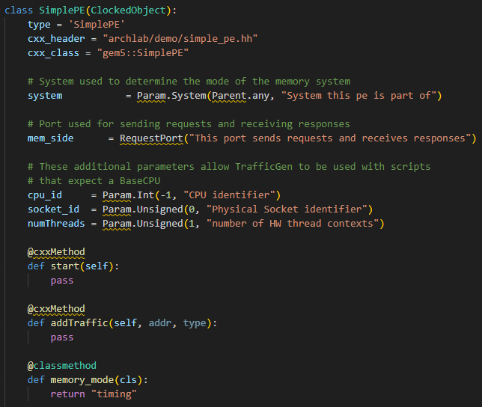
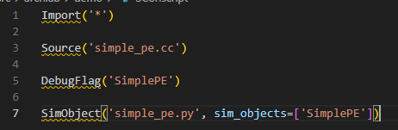
Create your object in gem5
You will need to add files under src/
my_obj.hh
my_obj.cc
my_obj.py
Sconscript
Sconscript.py
my_obj.py
https://www.gem5.org/documentation/learning_gem5/part2/helloobject/

Slide 24
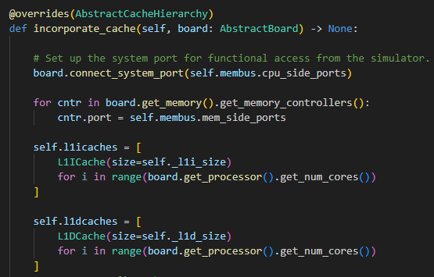
Develop class in python
Some datatype limit in python class
Follow the class inheritance relationship in python definition
Extract key api that python use
Adding your python object in
src/python
Update your file path in Sconscript

Slide 25
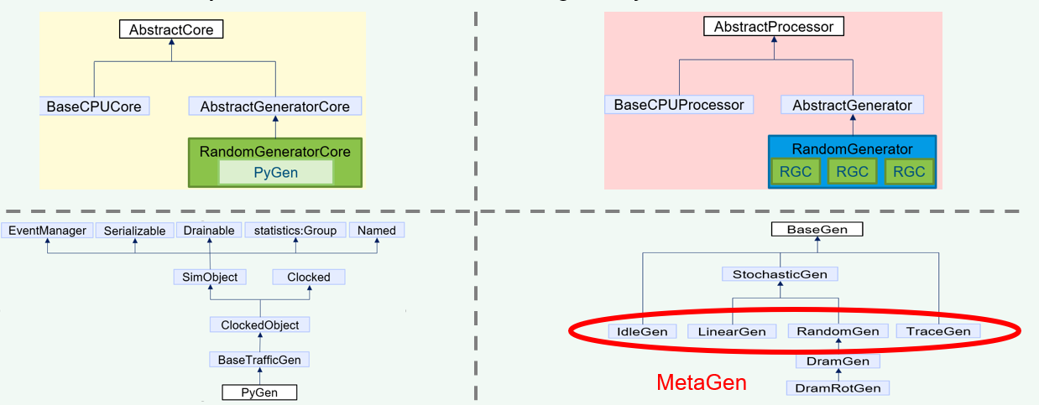
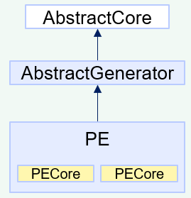
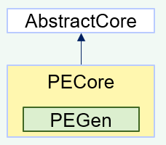
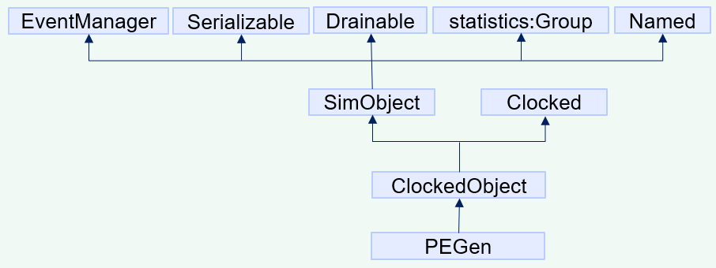
Create your object in python
Structure in gem5 repo
Our designed structure

Slide 26
Outline
Analytical Model
Event Driven Simulation
Gem5 Simulator
Gem5 Objects
Simulation Workflow
Functional Extension
Gem5 Object Connection
Hardware Structure
Configuration of Hardware Components with Gem5
Ruby Cache System

Slide 27
Hardware Structure
Memory
Common components
Processing Engine (PE)
Cache
Network on chip (NOC)
Memory
NOC
L2 cache
NOC
L1 cache
L1 cache
L1 cache
L1 cache
PE
PE
PE
PE
Typically, L1$ would be connected to PE directly

Slide 28
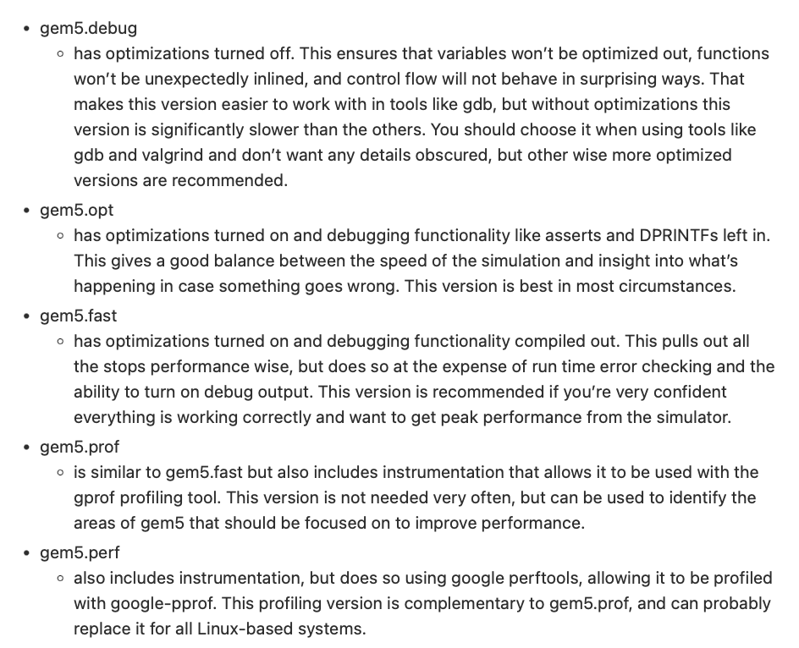
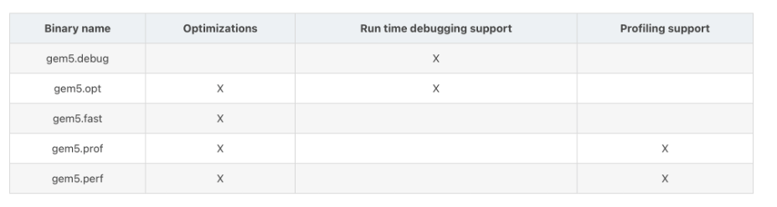
Build Binary Executable
Binary type
ISA (CPU)
Coherence protocol (Ruby cache system)
debug
X86
MESI_Two_Level
opt
arm
MESI_Three_Level
fast
Risc-v
MI_example
prof
NULL
MOESI_CMP

Slide 29
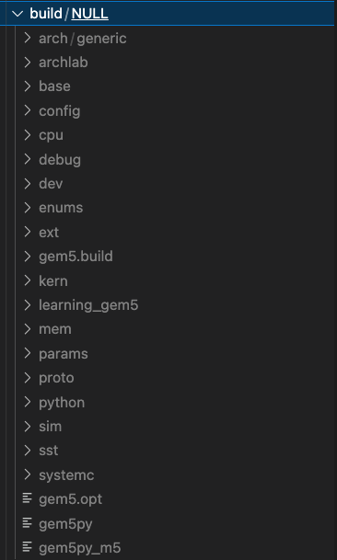
After Building
gem5/build
Most of Them are Only Link to Files within gem5/src
Start simulation
Binary Executable
Hardware configuration python file

Slide 30
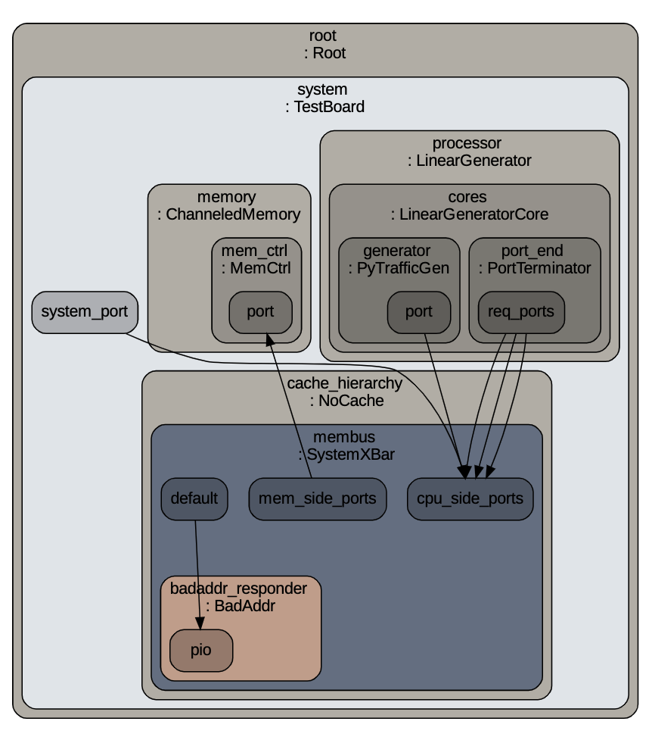
Gem5 Directory
gem5/configs
Write your configuration python file here
Describes Connection of components in Python
gem5/m5out
Stats of simulation
Hardware configuration chart
gem5/src
Define components in C/C++
src/python/gem5/components
Only use python class to describe components in configuration file

Slide 31
Configurable Components (classic system)
Board
PE (traffic generators)
Linear generator
Random generator
Cache hierarchy (classic cache system)
No cache
Private L1$
Private L1$, Private L2$
Private L1$, Shared L2$
NOC (initialized in cache hierarchy by function)
Memory
SingleChannelDD3_1600
SingleChannelDD3_2133
SingleChannelDD4_2400
DualChannelDDR3_1600
Etc.
See parameters in gem5/src/python/gem5/components

Slide 32
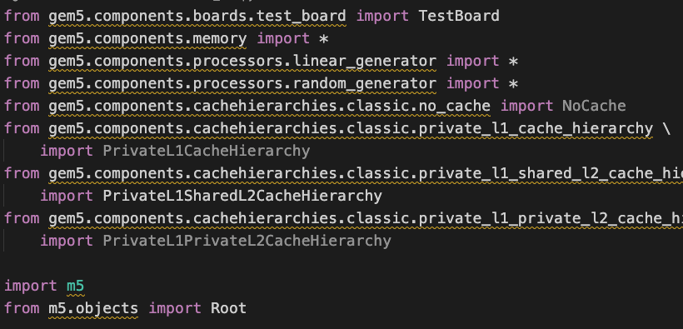
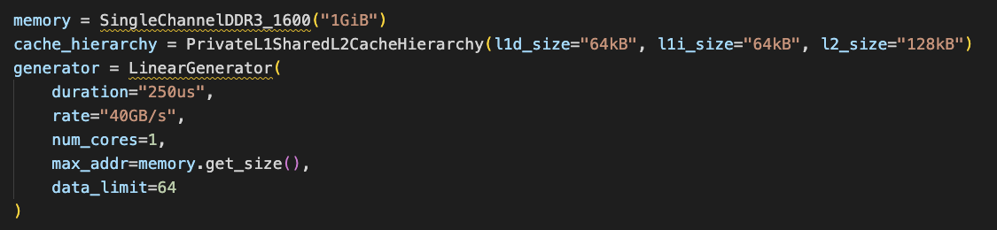
Configuration Template (board)
Import class you need
Configure each component
Instead of CPU, choosing
traffic generator to represent PE

Slide 33
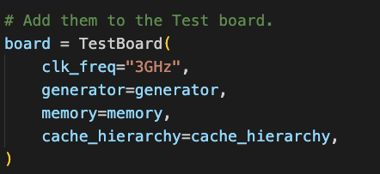
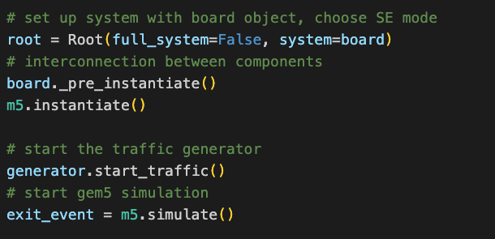
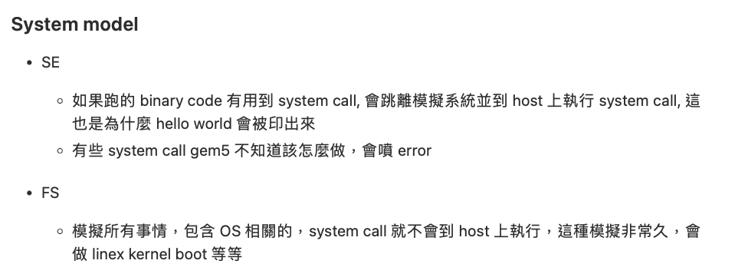
Configuration Template (board) Cont’d
Initialized a mother board
Only choose TestBoard due to no ISA CPU demands
33

Slide 34
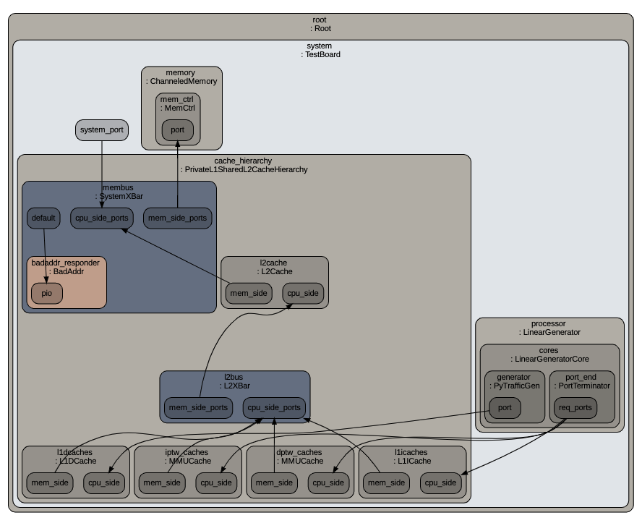
Xbar (NOC of classic system)
Xbar
CoherentXBar
L2Xbar
SystemXBar
NoncoherentXBar
gem5/src/mem/XBar.py
Connect components to memory
From PE, L1$, L2$ (multiple source)
SystemXBar (interconnection)
To one memory (single destination)

Slide 35
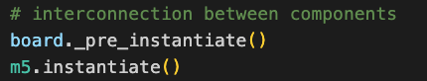
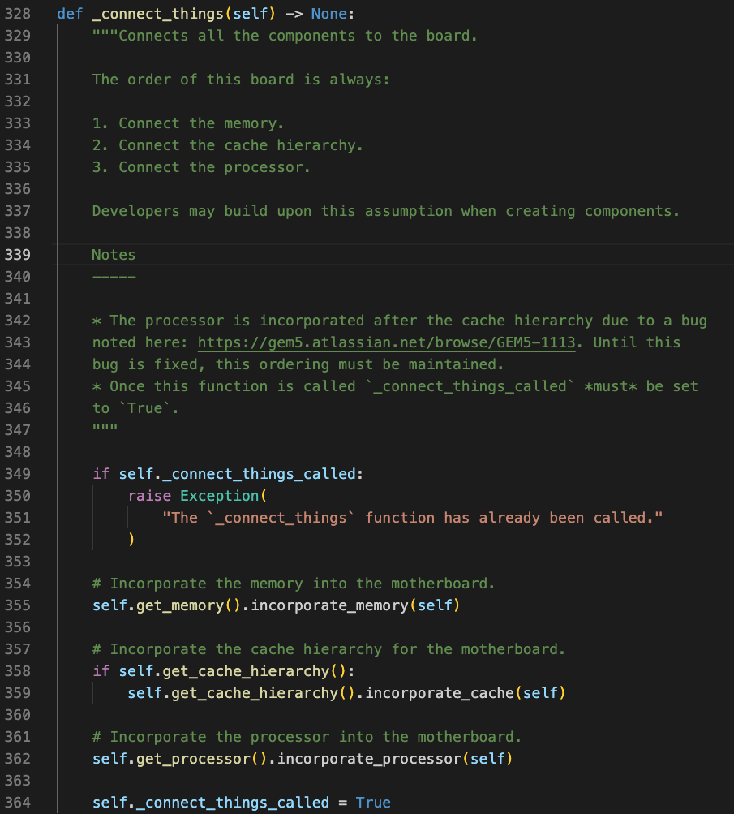
Connect Components By Yourself
gem5/src/python/gem5/components/boards/abstract_board.py
Board API could only connect:
1 PE, 1 cache, 1 memory

Slide 36
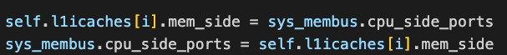
Connection Between Two Components
PE
Cache
XBar
Memory
CPU side ports
Above two expressions are same
Mem side ports

Slide 37
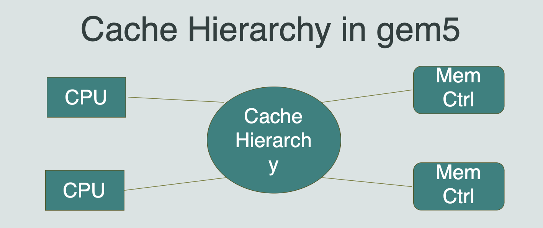
Cache Hierarchy In Gem5
Classic cache
Simplified
Faster
Less flexible configuration (strict structure)
Ruby
Model cache coherence in detail
More flexible configuration

Slide 38
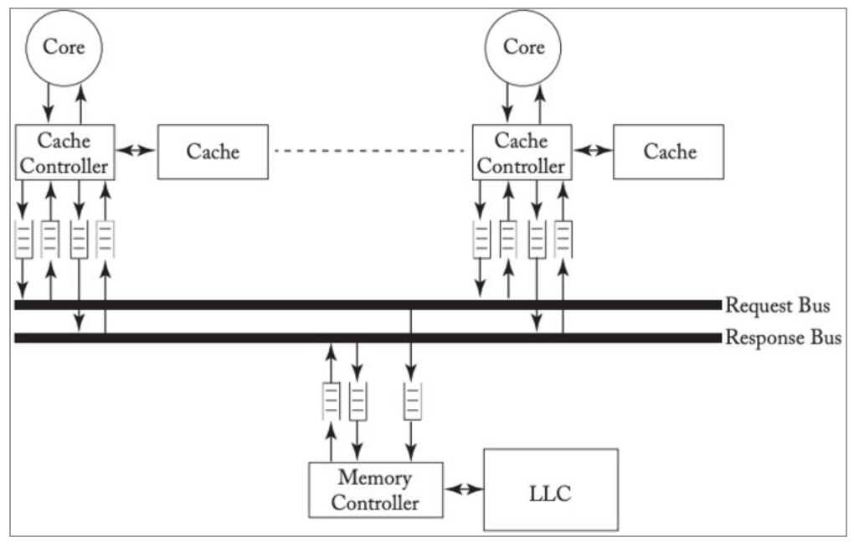
Coherency Protocols
Snoop protocol (classic cache system)
In a classic cache system, each processor monitors the bus to check if it has a copy of the requested cache line
Before a processor writes data, copies of the cache line in other processors' caches must be invalidated or updated
Does not scale well due to the need for an all-to-all broadcast

Slide 39
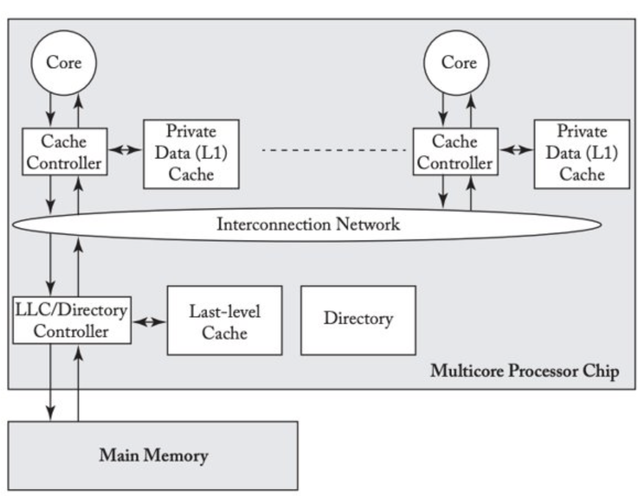
Coherency Protocol Cont’d
Snoop protocol(ruby cache system)
Directory tracks which processors have data when in the shared state
Local node where a request originates (interact with CPU cache)
Home node where the memory location of an address resides
Remote node has a copy of a cache block
A general interconnection network allows processors to communicate

Slide 40
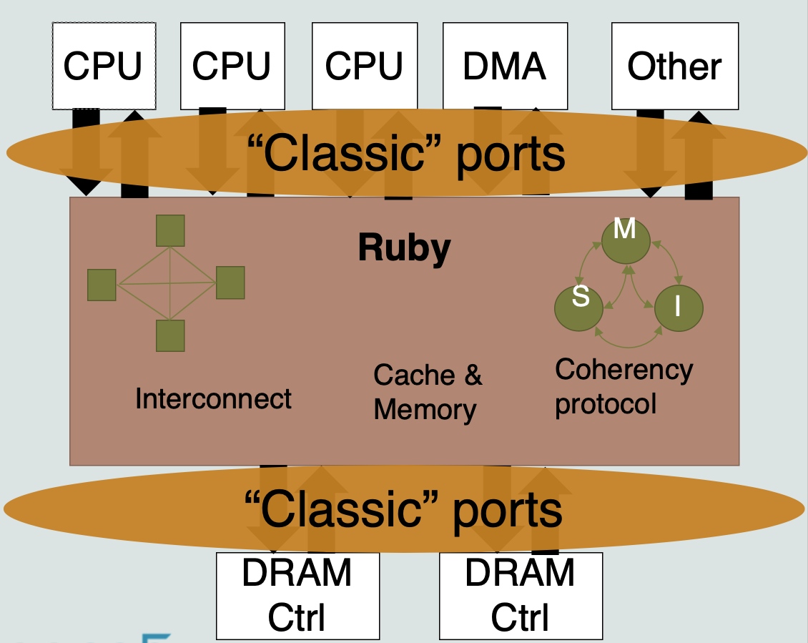
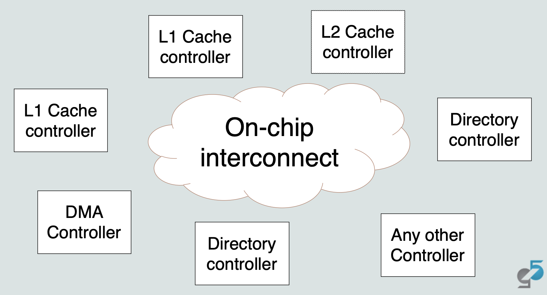
Overview Of Ruby System
Components
Controller models (cache controller, directory controller)
Controller topology (Mesh, all-to-all, etc.)
Network models
Interface (classic ports)
Caches

Slide 41
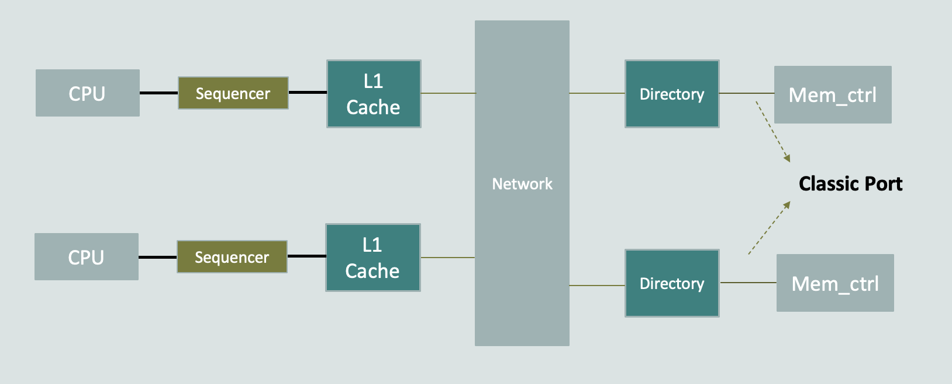
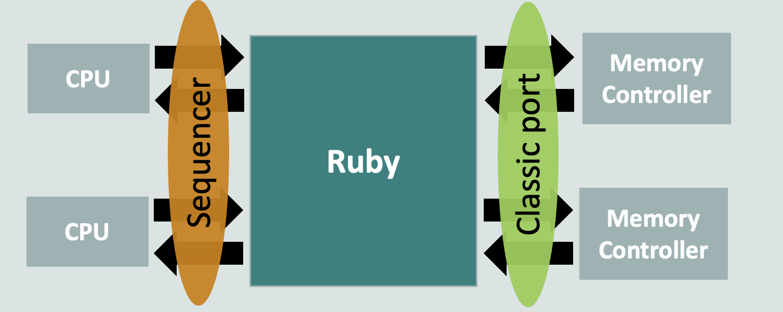
Connection between components
Classic CPU, Memory + Ruby cache system
Configuration steps
Create Controllers
Create Sequencers
Connect L1 controllers to sequencers
Connect Sequencers to CPUs
Connect Directories to memory controllers

Slide 42
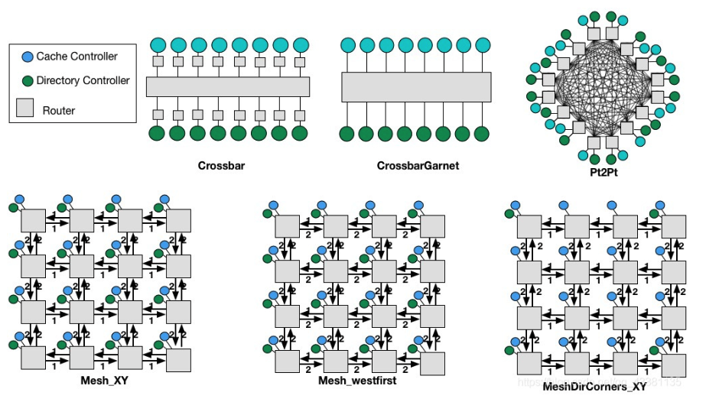
Topology

Slide 43
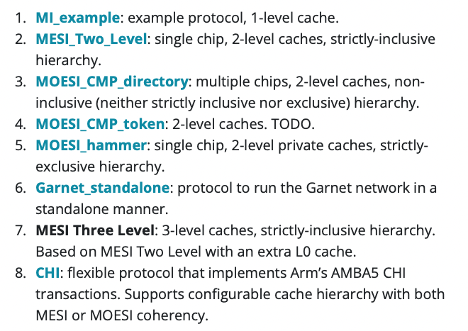
Coherence Protocols

Slide 44
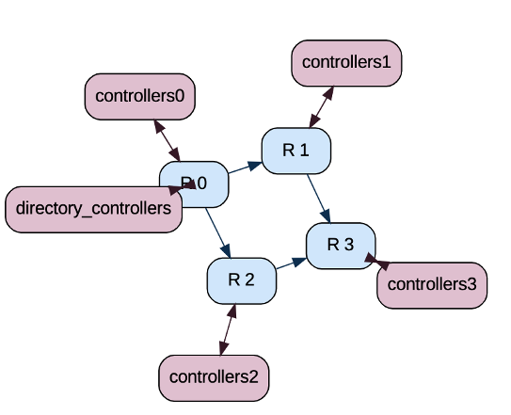
Link And Router
Router
Internal Link
External Link
Memory Control
Router
Cache

Slide 45
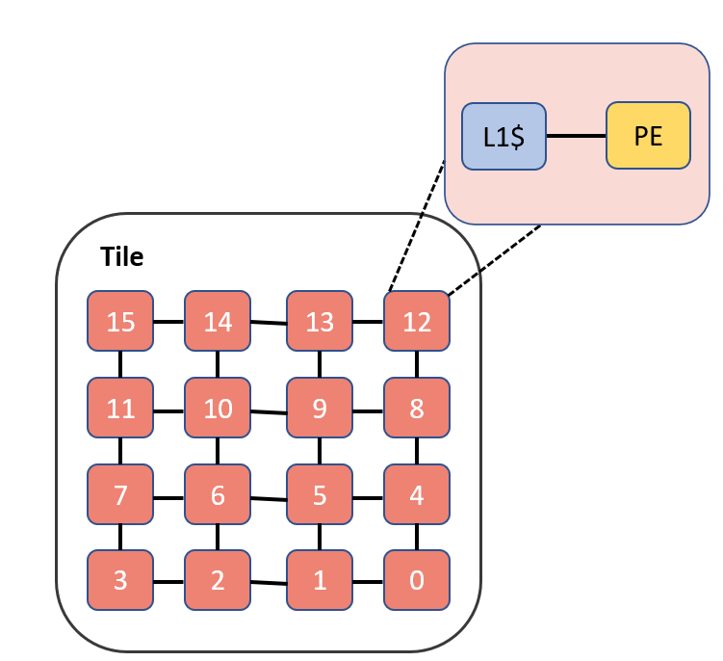
MESI Two Level – Mesh Topology (tile scalable)
Scalability
Could be extended to multi-tile
Tile
L2$Xbar
L2$Xbar
L2$
L2$
MemoryXbar
memory
GT-CHIPS/gem5_chips: gem5 repository to study chiplet-based systems (github.com)

Slide 46
Configuration Params
Parameters
L1$ size
L1$ association
L2$ size
L2$ association
Num of L2$ per tile
Num of cols per tile
Num of tiles
Num of PE per tile
Num of cols per tile
Num of PE per tile
L2$Xbar
Num of L2$ per tile
L2$
L2$
L2$
L2$
MemoryXbar
Num of tiles
memory

Slide 47
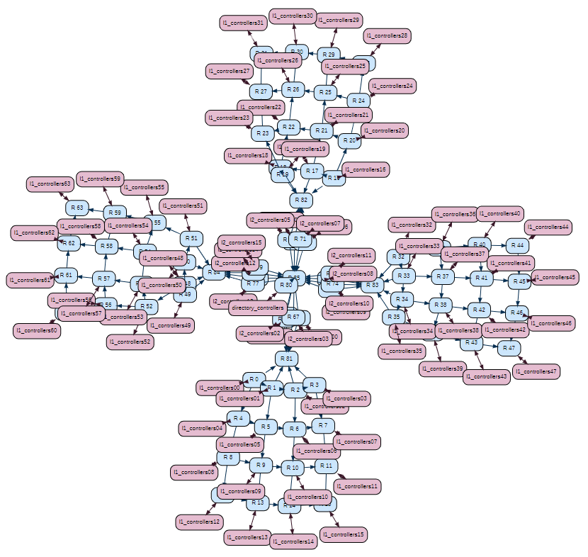
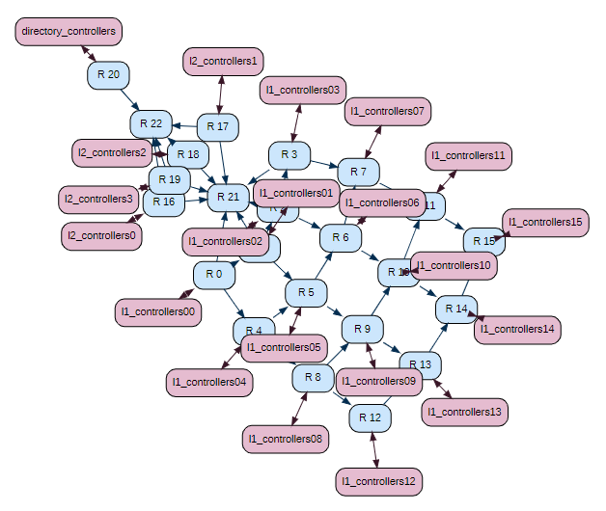
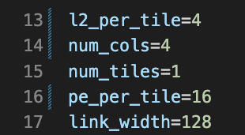
Configuration
Tile x 1
Tile x 4
./build/NULL/gem5.opt configs/archlab/lab2/ruby/tile_mesh.py

Slide 48
Related Files
gem5/src/python/gem5/components/cachehierarchies/ruby
lab447_mesi_two_level_cache_hierarchy.py
mesi_two_level_cache_hierarchy.py
topologies
garnet_pt2pt.py
gt_rocket.py
Mesh topology, tile scalable

